Slide 1
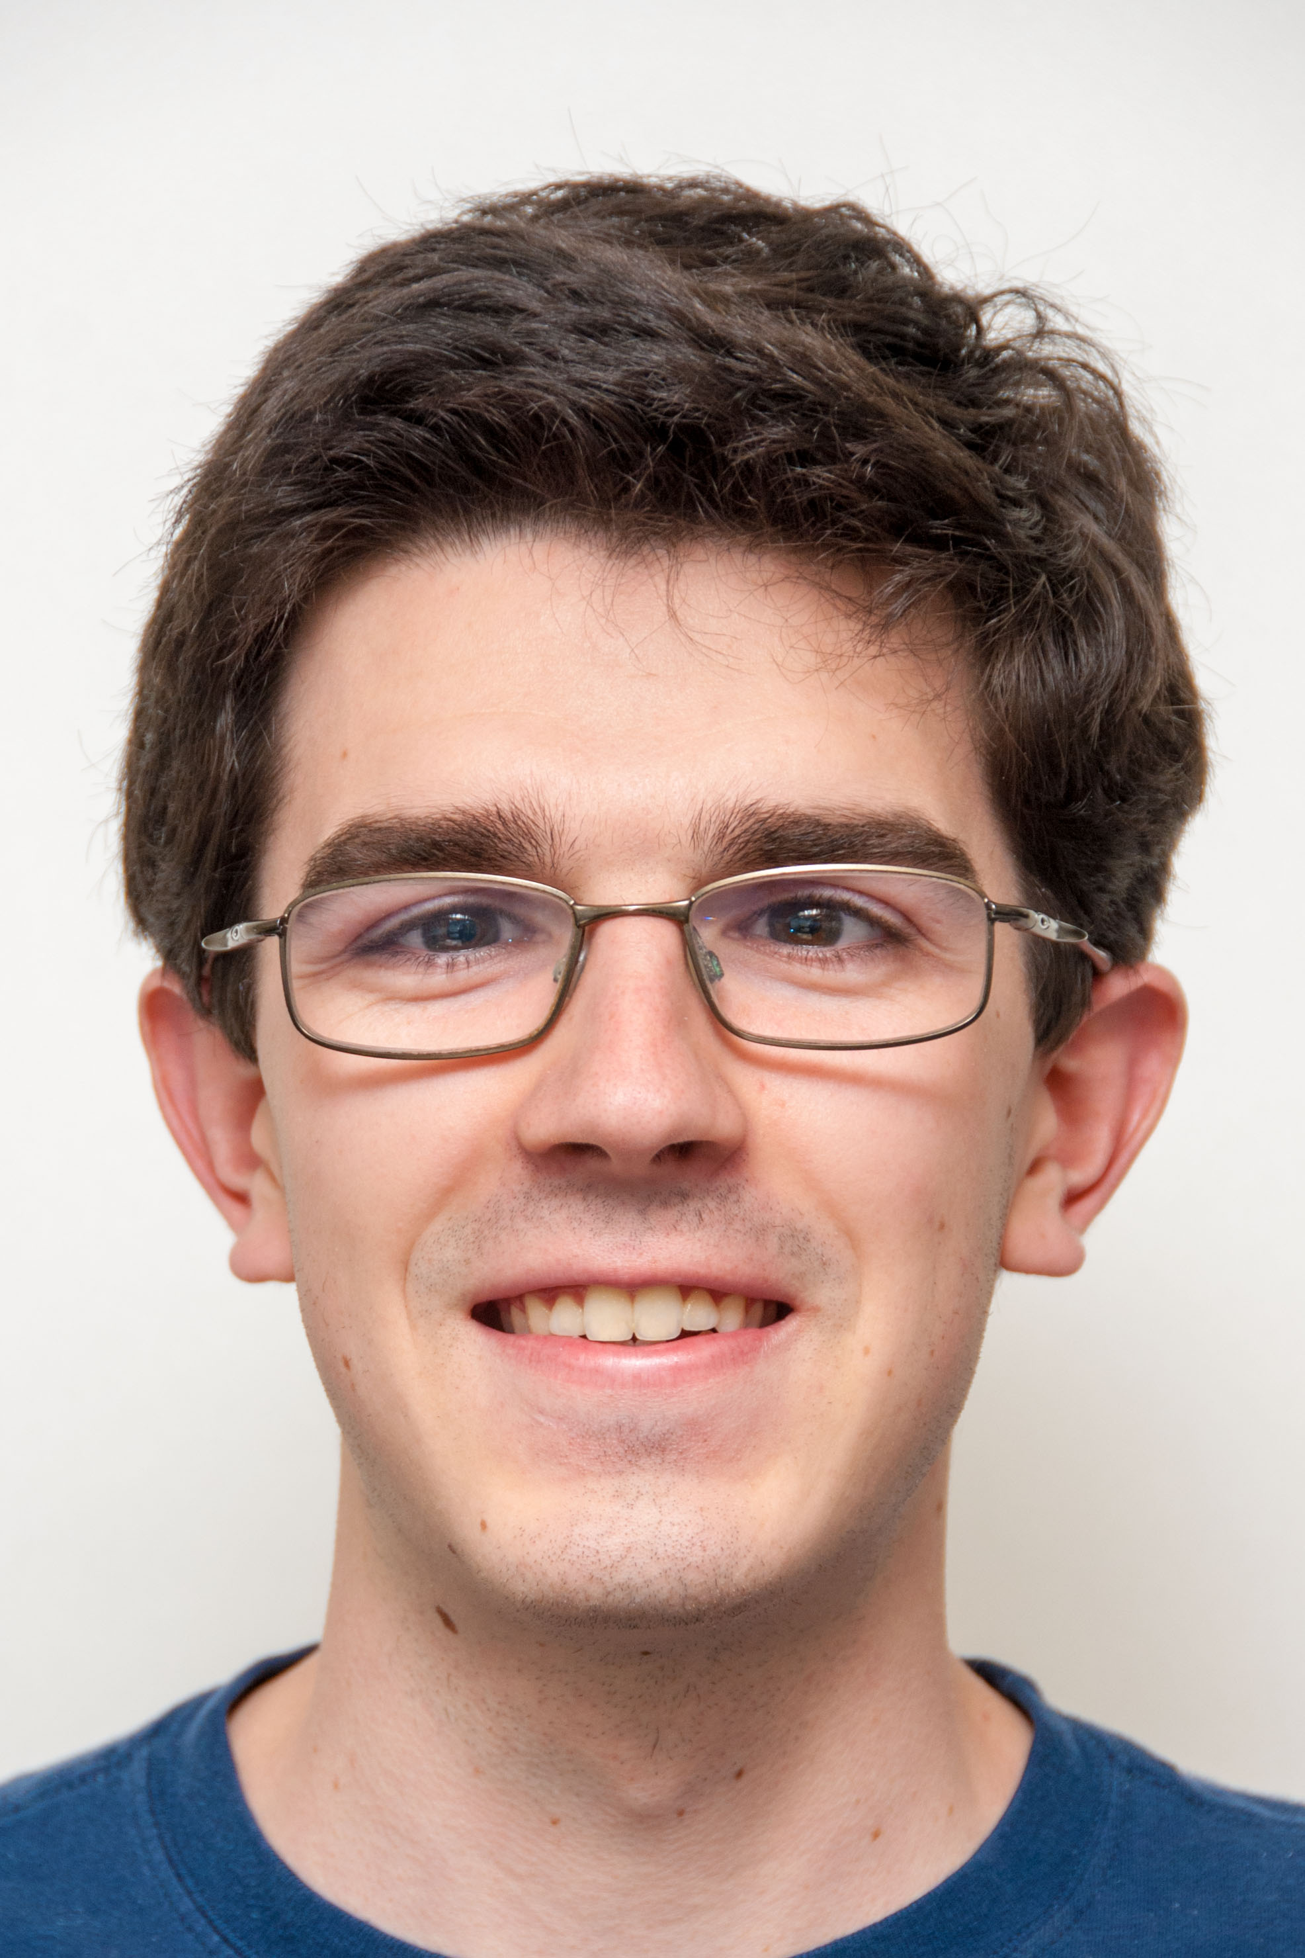


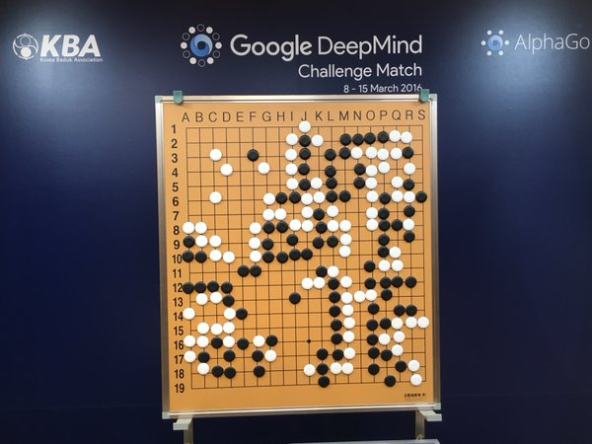
Google’s AlphaGo AI Beats World’s Best in Game 1
The Beauty and Joy of Computing Lecture #13 CS Education Research
Michael Ball
“AlphaGo, a program developed by Google's DeepMind unit, has defeated legendary Go player Lee Se-dol in the first of five historic matches being held in Seoul, South Korea. Lee resigned after about three and a half hours, with 28 minutes and 28 seconds remaining on his clock.”
http://www.theverge.com/2016/3/9/11184362/google-alphago-go-deepmind-result

Slide 2
Who am I?
I took CS10 Fall 2011
Graduated L&S CS Spring 2015
(Hopefully) MS CS Spring 2016!
TA’d CS10 for 3 years, and was Co-Instructor past summer
Research + Work in CS Education
Labs Autograder
Developing Snap!
Writing curriculum
Keeping websites running….
Why CS?
Lots of challenging, useful problems!
Connections to other fields — I love photography!

Slide 3
Admin: Autograded Labs
Snap! Labs: Can submit through bCourses now!
You can get checked off either way
EXCEPTION: Lab 11 is required through bCourses
Sorry if there’s bugs in the score posting!
All the submissions are logged, and I’ll fix bCourses
Demo
https://bcourses.berkeley.edu/courses/1408649/assignments/7531220
Hopefully: extra autograded practice problems
Just for fun, not really for a grade.

Slide 4
Outline
What is CS Education Research?
How can we use CS, technology to teach better?
How can we learn to teach CS better?
Recently: How can we scale CS? Increase diversity?
Where does CS10 come in?
History
Where we are now
The Future
How can you get involved?

Slide 5
CS Education

Slide 6
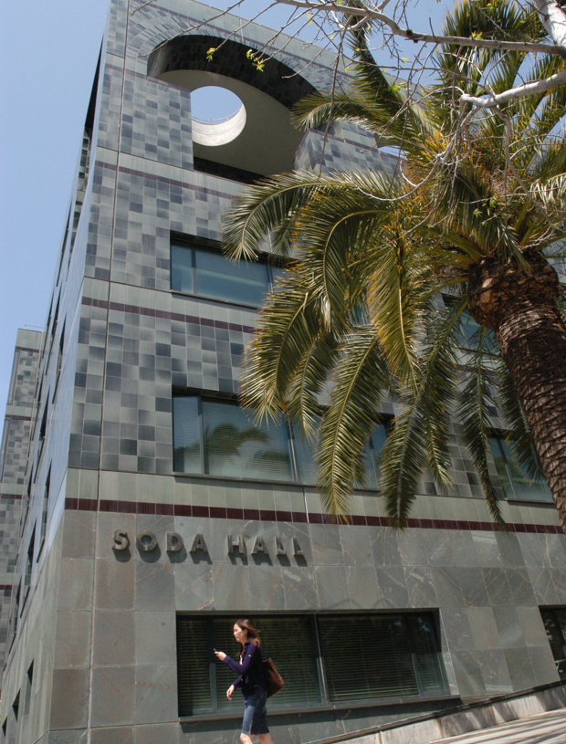
Computer Science … A UCB view
www.eecs.berkeley.edu/Research/Areas/
CS research areas:
Artificial Intelligence
Biosystems & Computational Biology
Database Management Systems
Education
Graphics
Human-Computer Interaction
Networking
Programming Systems
Scientific Computing
Security
Systems
Theory
…

Slide 7
Education Research (with a CS lens)
Goal: Improve teaching & learning for ”all” disciplines (if possible)
Why get computer scientists involved?
Unique position to build tools
edX, bCourses (Canvas) were started by ‘CS people’
CS overlaps with relevant fields
Human-Computer Interaction
Cognitive Science
More Recently: Artificial Intelligence
Best research requires collaboration!!

Slide 8
What Questions Do We Ask?
What is the best use for lecture time?
”Flipped Classroom” where students watch videos for HW and do ‘homework’ in lecture
“Active Learning” — techniques to keep you involved in a lecture, like iClickers.
How can we leverage new data to understand students better?
”MOOCs”– Massive Open Online Courses
What changes when 100,000 people take a course together?

Slide 9
iClicker: Meta Question
Have you taken a class (other than CS10) that:
A) Uses iClickers (or similar) during lecture?
B) Uses a ‘flipped’ classroom style
C) Both A and B (can be multiple courses)
D) Neither A nor B

Slide 10
iClicker: Meta Question 2
How helpful do you find iClickers in CS10?
A) Very Unhelpful
B) Somewhat Unhelpful
C) Neither helpful or unhelpful
D) Somewhat helpful
E) Very helpful

Slide 11
Improving CS Education
Goal: Make learning and teaching CS easier, and more accessible
CS students dropout and struggle more than other majors.
Lower percentage of women studying CS today than were 20 years ago.
UNI: Enrollments are booming, and we don’t know what to do…
HS: Very few teachers are ready to teach CS in High Schools.

Slide 12
Retention and Dropout
2012 PCAST Report [Read]
Fewer than 40% of students who enter college intending to major in a STEM field complete a STEM degree.
High‐performing students frequently cite uninspiring introductory courses as a reason for switching majors.
Possible solutions:
Create new classes! (like CS10)
Connect CS to other disciplines
DATA8 is doing this for Stats / Data Science
More support programs on campus
Berkeley: HKN / UPE, CS Mentors, CS Scholars, AWE, WISE, Peer Advising, Hackers@Berkeley, others?

Slide 13
Diversity in CS
Major focus of past few years!
Goes beyond gender – race / ethnicity, disabilities, more all lacking representation
CS10: First CS course at Berkeley with gender parity!
What can we do?
Do everything on the previous slide!
Recruit people we want
Work on the environment — train TAs and teachers
Work on the environment — Use ‘neutral’ décor
Create a pipeline – We’ll get to this later.

Slide 14
Booming University Enrollments
CS61A – ~200 → 1,400 students in 4 years
CS10 – ~80 → 320 students in 4 years
Not enough faculty or TAs (most places!)
What tools do we need to handle this many students?
How do we train TAs?
What else changes? Assignments? Cheating?

Slide 15
Creating High School CS Environment
About 1 in 10 high schools offer a CS course
Growing quickly in recent years!
Equity and access issues
Computing can be expensive!
Gender and Racial diversity has been low in HS too.
NSF: CS10K Project, ~5 years to get 10,000 High School CS Teachers
Creating new curriculum
AP Computer Science Principles, BJC
LOTS of Professional Development / Training

Slide 16
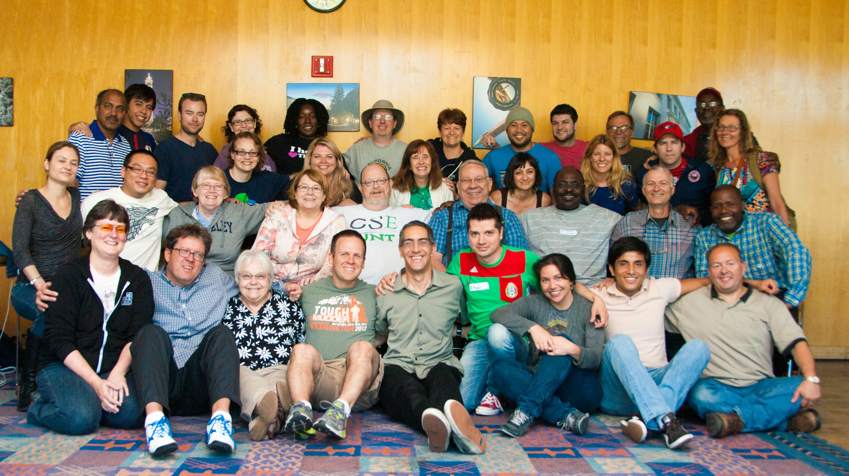
The CS10K Project
Goal: get engaging, rigorous computing curricula into computing courses in 10,000 high schools, taught by 10,000 well-prepared teachers by 2016.
Notes:
There are two courses that have been developed as part of this effort. The first Exploring Computer Science (ECS) is a preAp course and there are a number of other, existing courses that could fill that niche.
CS Principles is the new AP course.
Pictures shows teachers trained on ECS in LA.

Slide 17
CS10’s Place

Slide 18
iClicker Question: History
How early can we trace the history of CS10?
1920’s
1940’s
1960’s
1980’s
2000’s

Slide 19
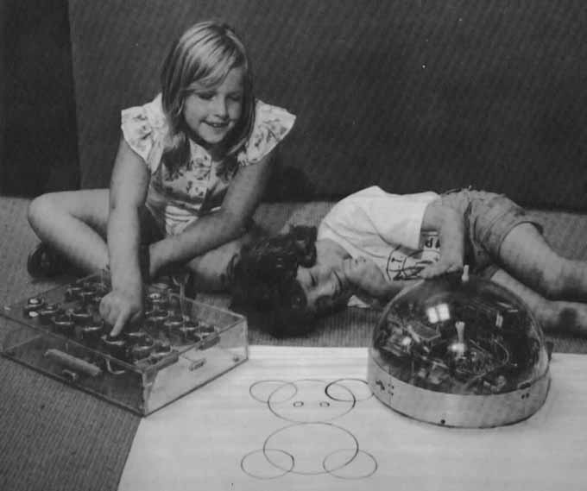
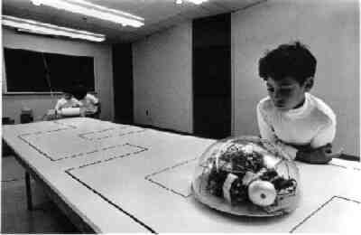
Robot Turtles
http://neoparaiso.com/logo/imagenes/historia-logo-01.jpg
The turtle was an early educational robot introduced in the 1940’s
http://www.bfoit.org/Intro_to_Programming/images/mindstorms_turtle.jpg
http://neoparaiso.com/logo/imagenes/historia-logo-01.jpg

Slide 20
Logo, Etoys, Scratch and BYOB
Seymour Papert creates Logo in 1967
Key educational feature is “turtle graphics”
Current most popular implementation is UCBLogo
Many visual versions of Logo exist
Etoys – 1990’s environment for kids
Scratch – 2002-now: blocks programming for everyone
BYOB – 2009, a version of Scratch to teach CS
BYOB was renamed Snap! And re-written to work in the browser

Slide 21
CS10 at Berkeley
2009: Dan Garcia and Brian Harvey replace CS3 with CS10
CS3 was (old school) CS61A-lite
No graphics / media, no additional topics, no social implications
CS10 : “The Beauty and Joy of Computing
Survey course w/ lots of programming!
Individual, custom projects
A writing assignment (say wat.)

Slide 22
Computer Science Principles and BJC
Same time: new AP Course, “CSP”
CSP – a mash up of courses like CS10
BJC becomes a pilot
Students make good guinea pigs! <3
Collaboration with many others
NC State, U Alabama
BJC4NYC
3 years, 100 NYC classrooms
Rewriting everything (basically)
edX MOOC
16,000 Students!

Slide 23
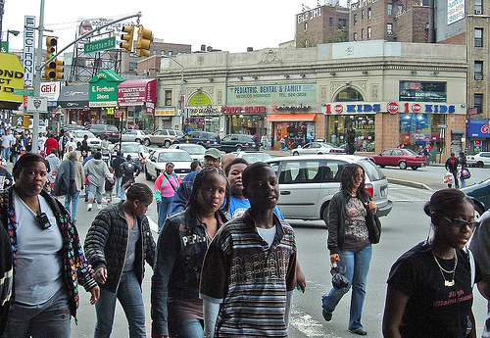


NSF’s STEM-C: BJC4NYC
We’re working with the NYC school district to bring BJC to 100 NYC teachers by 2020!
Grant #1441075

Slide 24
Join CS10 and / or Do Research
TAs at Berkeley have LOTS of responsibility
Path: Lab Assistant → Reader → TA
You can to make design / scheduling / grading decisions
edX development, Snap! Development

Slide 25
Join CS10 and / or Do Research
TAs at Berkeley have LOTS of responsibility
Path: Lab Assistant → Reader → TA
You can to make design / scheduling / grading decisions
edX development, Snap! Development

